Slide 1
The Buffer Cache

Slide 2
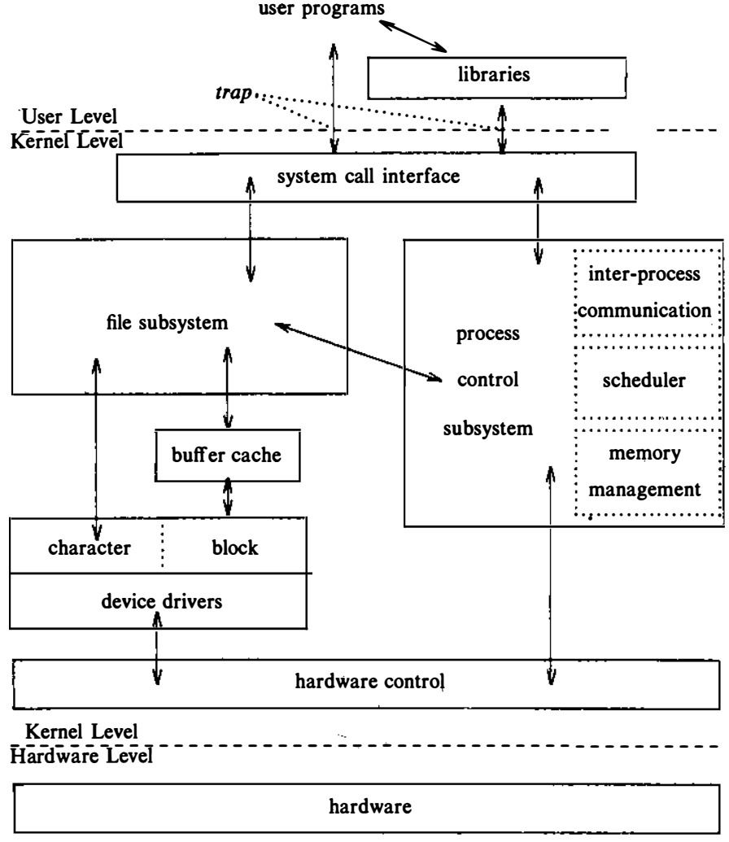
The Buffer Cache
The kernel could read and write directly to and from the disk for all file system accesses.
System response time and throughput would be poor because of the slow disk transfer rate.
Fig: Architecture of The Unix Operating System

Slide 3
The Buffer Cache
The kernel therefore attempts to minimize the frequency of disk access by keeping a pool of internal data buffers, called the buffer cache.
Fig: Architecture of The Unix Operating System

Slide 4
The Buffer Cache
When reading data from the disk, the kernel attempts to read from the buffer cache.
If the data is already in the cache?
If yes, the kernel does not have to read from the disk.
If No, the kernel reads the data from the disk and caches it.
Data being written to disk is cached so that it will be there if the kernel later tries to read it.
The kernel minimizes the frequency of disk write operations
Delay-write data to maximize the caching effect.

Slide 5
The Buffer Cache
Parts of a buffer
A memory array
A buffer header
Contains data from the disk
Identifies the buffer.
There is a one to one mapping of buffer headers to data arrays.
The kernel identifies the buffer contents by examining identifier fields in the buffer header.

Slide 6
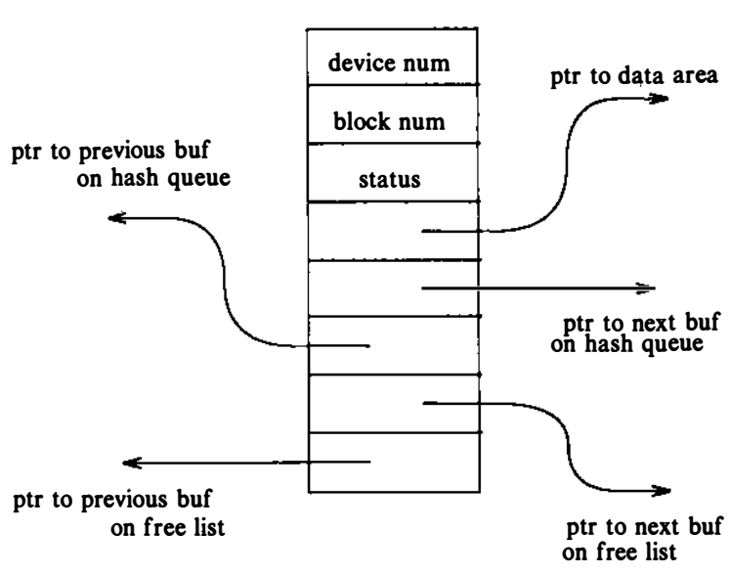

Buffer Header
The buffer header contains
A device number field that specify the file system
A block number field that specify the block number of the data on disk and uniquely identify the buffer.

Slide 7
Buffer Header
The buffer header also contains
A pointer to a data array for the buffer, whose size must be at least as big as the size of a disk block, and
A status field that summarizes the current status of the buffer.

Slide 8
Buffer Header
The status of a buffer is a combination of the following conditions:
The buffer is currently locked
The buffer contains valid data
The kernel must write the buffer contents to disk before reassigning the buffer (delayed-write)
The kernel is currently reading or writing the contents of the buffer to disk
A process is currently waiting for the buffer to become free.
The buffer header also contains two sets of pointers, used by the buffer allocation algorithms to maintain the overall structure of the buffer pool

Slide 9
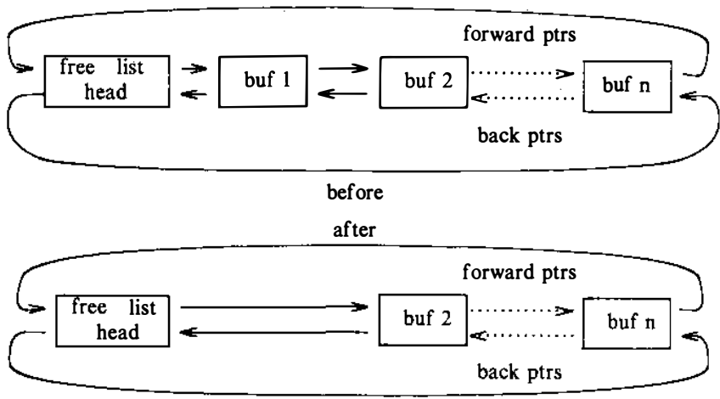
Structure of the Buffer Pool
The kernel caches data in the buffer pool according to a least recently used algorithm.
The kernel maintains a free list of buffers that preserves the least recently used order.
Fig: Free List of Buffers

Slide 10
Structure of the Buffer Pool
The free list is a doubly linked circular list of buffers with a dummy buffer header that marks its beginning and end.
Fig: Free List of Buffers

Slide 11
Structure of the Buffer Pool
Every buffer is put on the free list when the system is booted.
The kernel takes a buffer from the head of the free list when it wants any free buffer
Fig: Free List of Buffers

Slide 12
Structure of the Buffer Pool
When the kernel returns a buffer to the buffer pool, it usually attaches the buffer to the tail of the free list
The buffers that are closer to the head of the free list have not been used as recently
Fig: Free List of Buffers

Slide 13
Structure of the Buffer Pool
When the kernel accesses a disk block, it searches for a buffer with the appropriate device-block number combination.
Rather than search the entire buffer pool, it organizes the buffers into separate queues, hashed as a function of the device and block number.
The kernel links the buffers on a hash queue into a circular, doubly linked list, similar to the structure of the free list.

Slide 14
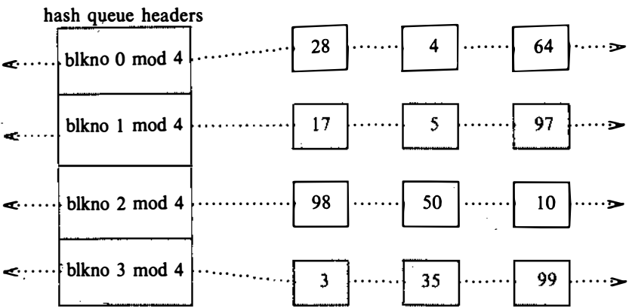
Structure of the Buffer Pool
Fig. shows buffers on their hash queues
The squares marked 28, 4, and 64 represent buffers on the hash queue for block number 0 modulo 4 .
Each buffer always exists on a hash queue, but there is no significance to its position on the queue.
Fig: Buffers on the Hash Queues

Slide 15
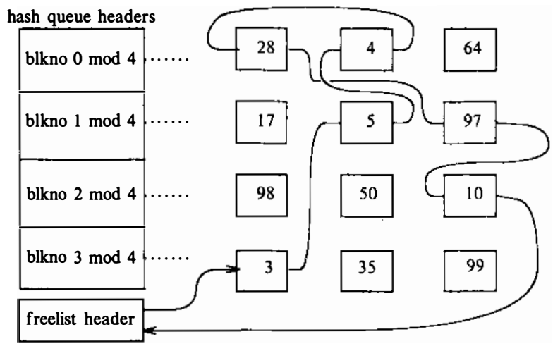
Structure of the Buffer Pool
Fig: Structure of the Buffer

Slide 16
Scenarios for retrieval of a buffer
The high-level algorithms determine the device number and block number that they wish to access when they attempt to retrieve a block.
For example, if a process wants to read data from a file, the kernel determines which file system contains the file and which block in the file system contains the data
When about to read data from a particular disk block, the kernel checks whether the block is in the buffer pool and, if it is not there, assigns it a free buffer.

Slide 17
Scenarios for retrieval of a buffer
When about to write data to a particular disk block, the kernel checks whether the block is in the buffer pool
if not, assigns a free buffer for that block. The algorithms for reading and writing disk blocks use the algorithm getblk to allocate buffers from the pool.
When the kernel finishes using the buffer, it releases the buffer according to algorithm brelse.

Slide 18
Scenarios for retrieval of a buffer
We have five scenarios the kernel may follow in getblk to allocate a buffer for a disk block.
The kernel finds the block on its hash queue, and its buffer is free.
The kernel cannot find the block on the hash queue, so it allocates a buffer from the free list.
The kernel cannot find the block on the hash queue and, in attempting to allocate a buffer from the free list (as in scenario 2), finds a buffer on the free list that has been marked delayed write. The kernel must write the delayed write buffer to disk and allocate another buffer.
The kernel cannot find the block on the hash queue, and the free list of buffers is empty.
The kernel finds the block on the hash queue, but its buffer is currently busy.

Slide 19
Scenarios for retrieval of a buffer
Scenario I: The kernel finds the block on its hash queue, and its buffer is free.
The kernel searches for a block in the buffer pool by its device-block number combination and finds the hash queue that should contain the block.
The kernel checks that the buffer is free and, if so, marks the buffer busy so that other processes cannot access it.
Other process trying to access the same block => Sleep

Slide 20
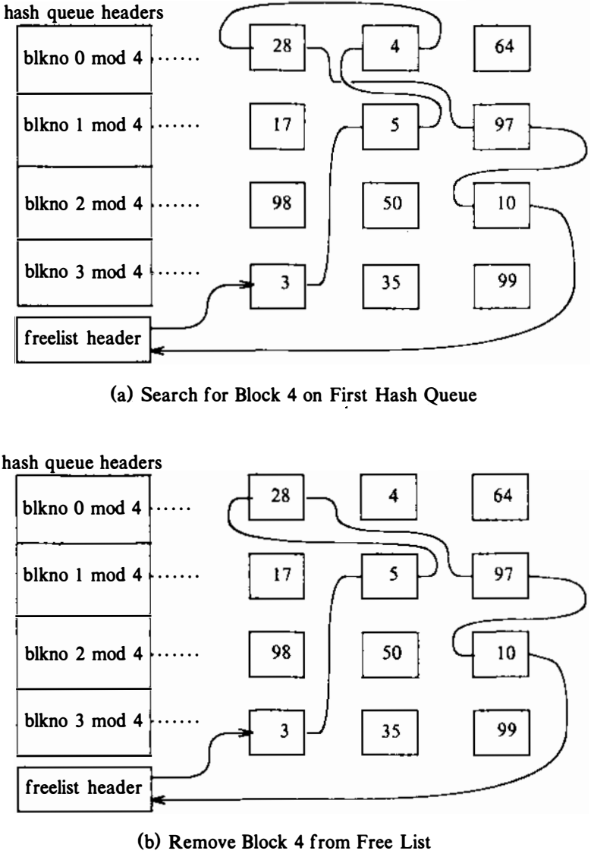
Scenarios for retrieval of a buffer
Kernel requires block number 4

Slide 21
Scenarios for retrieval of a buffer
Scenario II: The kernel cannot find the block on the hash queue, so it allocates a buffer from the free list.
The kernel searches the hash queue that should contain the block but fails to find it there.
So the kernel removes the first buffer from the free list.
If the buffer has not been marked for a delayed write.

Slide 22
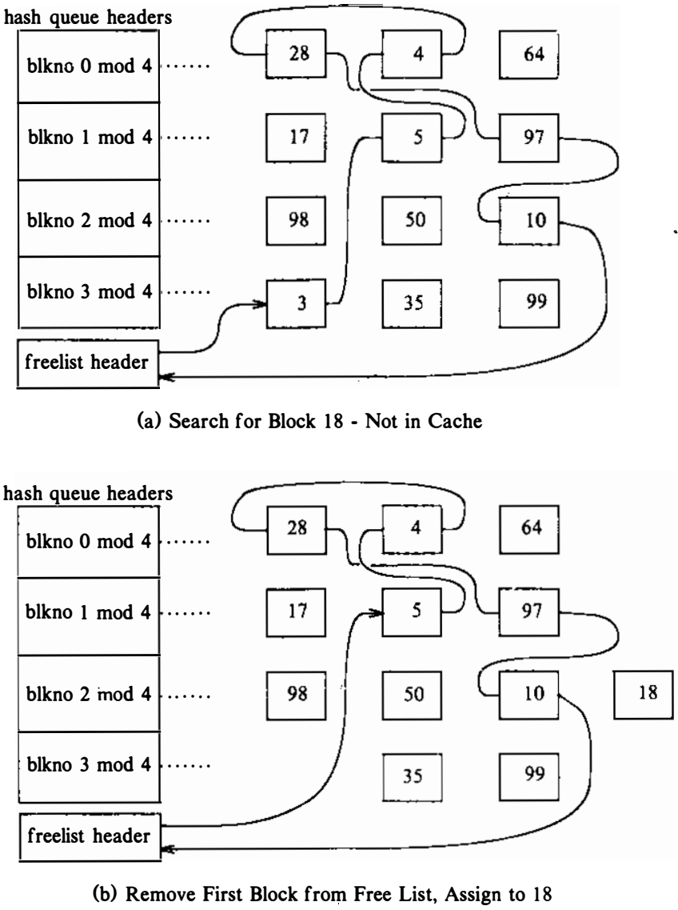
Scenarios for retrieval of a buffer
Kernel requires block number 18

Slide 23
Scenarios for retrieval of a buffer
Scenario III: The kernel cannot find the block on the hash queue and, in attempting to allocate a buffer from the free list, finds a buffer on the free list that has been marked delayed write.
The kernel also has to allocate a buffer from the free list. However, it discovers that the buffer it removes from the free list has been marked for delayed write, so it must write the contents of the buffer to disk before using the buffer.
The kernel removes it from the free list, starts write operations to disk for the blocks
The kernel tries to allocate another buffer from the free list
When the write completes, the kernel releases the buffer and places it at the head of the free list.

Slide 24
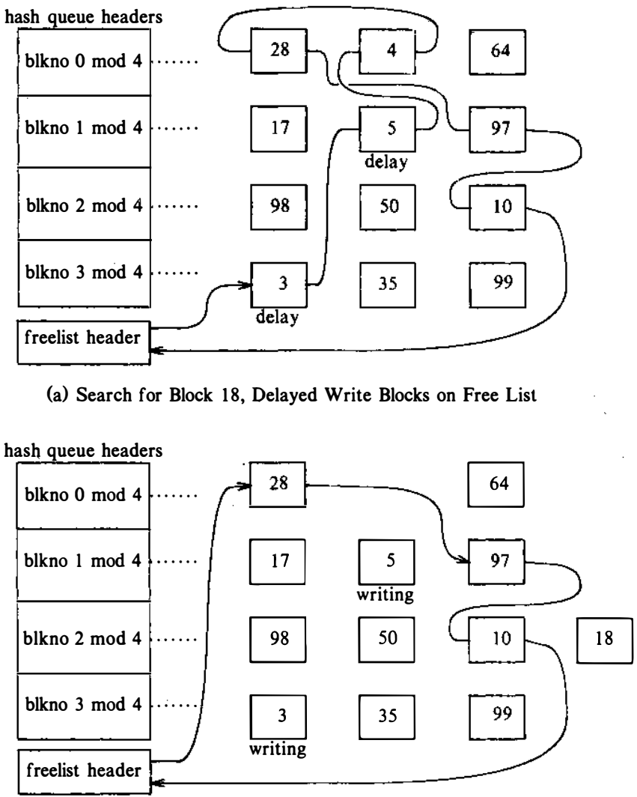
Scenarios for retrieval of a buffer
The kernel searches for block number 18

Slide 25
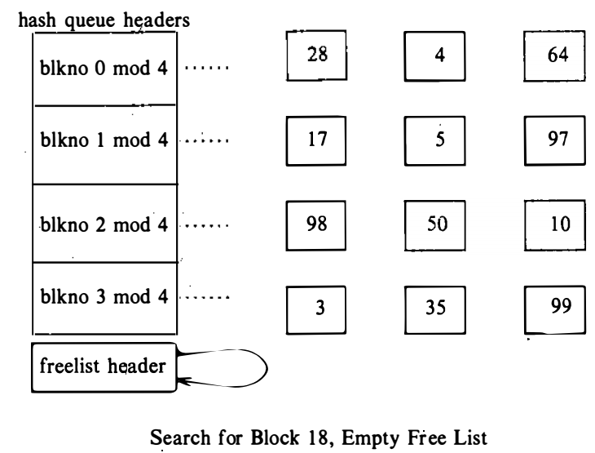
Scenarios for retrieval of a buffer
Scenario IV: The kernel cannot find the block on the hash queue, and the free list of buffers is empty.
The kernel cannot find the disk block on its hash queue, so it attempts to allocate a new buffer from the free list.
However, no buffers are available on the free list, so process goes to sleep until another process executes algorithm brelse, freeing a buffer.

Slide 26
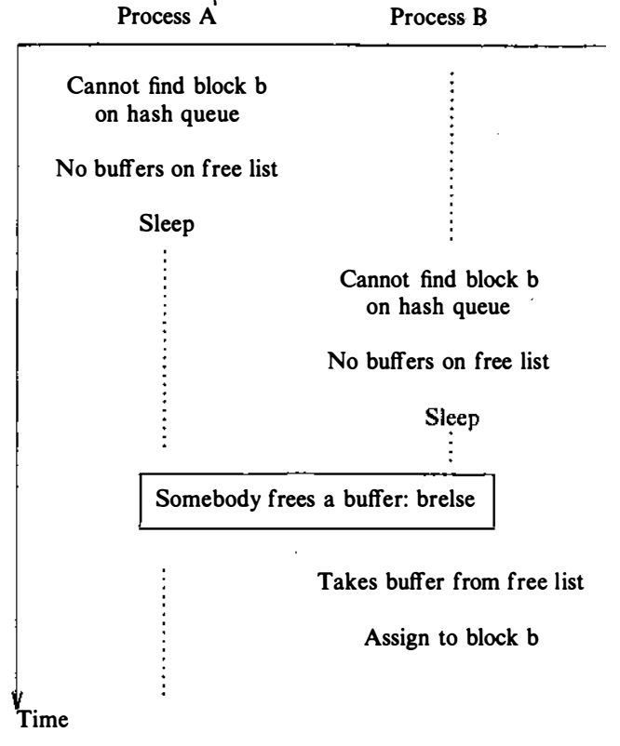
Scenarios for retrieval of a buffer
Scenario IV: The kernel cannot find the block on the hash queue, and the free list of buffers is empty.
When the kernel schedules process A, it must search the hash queue again for the block.
It cannot allocate a buffer immediately from the free list, because it is possible that several processes were waiting for a free buffer and that one of them allocated a newly freed buffer for the target block sought by process A.
Fig: Race for Free Buffer

Slide 27
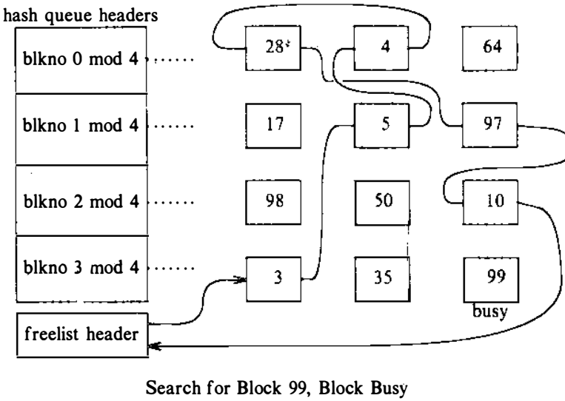
Scenarios for retrieval of a buffer
Scenario V: The kernel finds the block on the hash queue, but its buffer is currently busy.
It involves complex relationships between several processes.

Slide 28
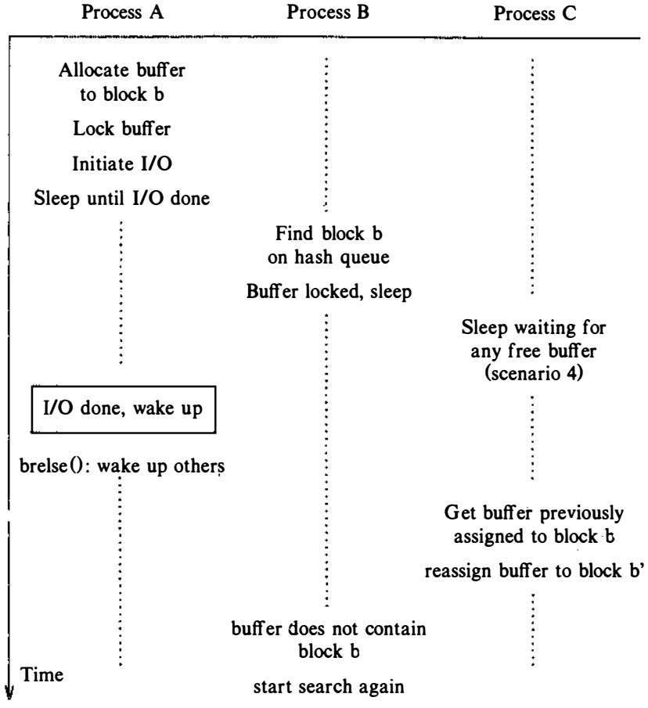
Scenarios for retrieval of a buffer
Scenario V
If process A attempts to read a disk block and allocates buffer as in scenario II, suppose it will sleep while it waits for the I/O transmission from disk, to complete.
While process A sleeps, suppose the kernel schedules a second process, B, which tries to access the disk block whose buffer was just locked by process A.
Process B (going through scenario 5) will find the locked block on the hash queue.
Fig: Race for a Locked Buffer

Slide 29
Scenarios for retrieval of a buffer
Scenario V
Since it is illegal to use a locked buffer and it is illegal to allocate a second buffer for a disk block, process B marks the buffer "in demand" and then sleeps and waits for process A to release the buffer
Fig: Race for a Locked Buffer

Slide 30
Scenarios for retrieval of a buffer
Scenario V
Process A will eventually release the buffer and notice that the buffer is “in demand”. It awakens all processes sleeping on the event "the buffer becomes free,“ including process B.
When the kernel again schedules process B, process B must verify that the buffer is free.
Another process, C, may have been waiting for the same buffer, and the kernel may have scheduled C to run before process B; process C may have gone to sleep leaving the buffer locked.
Hence, process B must check that the block is indeed free
Fig: Race for a Locked Buffer

Slide 31
Scenarios for retrieval of a buffer
Scenario V
Process B must also verify that the buffer contains the disk block that it originally requested, because process C may have allocated the buffer to another, block, as in scenario 2.
When process B executes, it may find that it had been, waiting for the wrong buffer, so it must search for the block again: If it were to allocate a buffer automatically from the free list, it would miss the possibility that another process just allocated a buffer for the block.
Fig: Race for a Locked Buffer

Slide 32
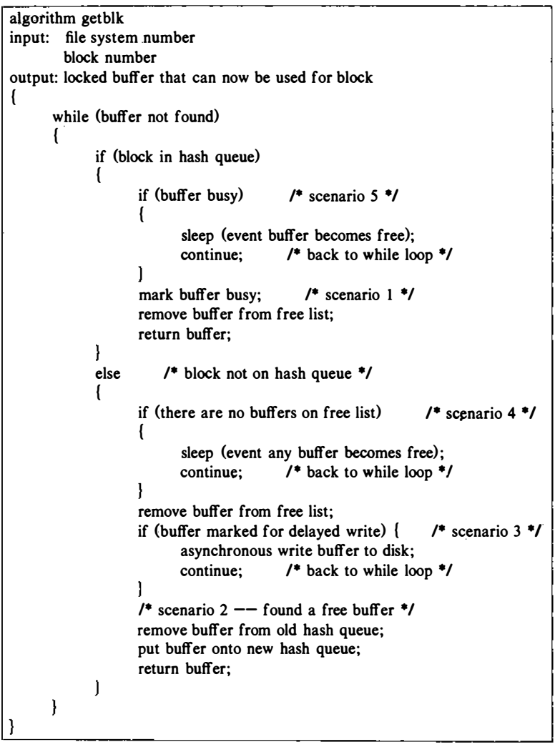
Algorithm for Buffer Allocation

Slide 33
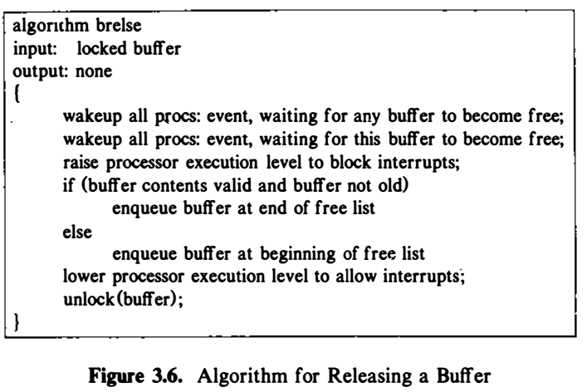
Releasing a buffer

Slide 34
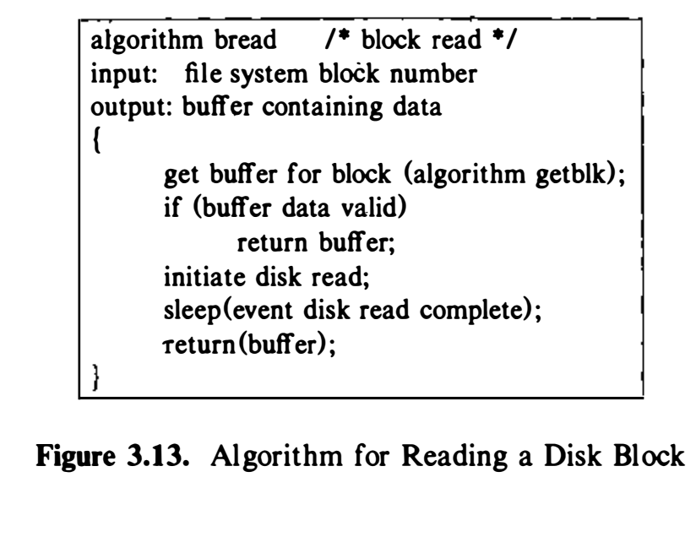
Reading and writing disk blocks

Slide 35
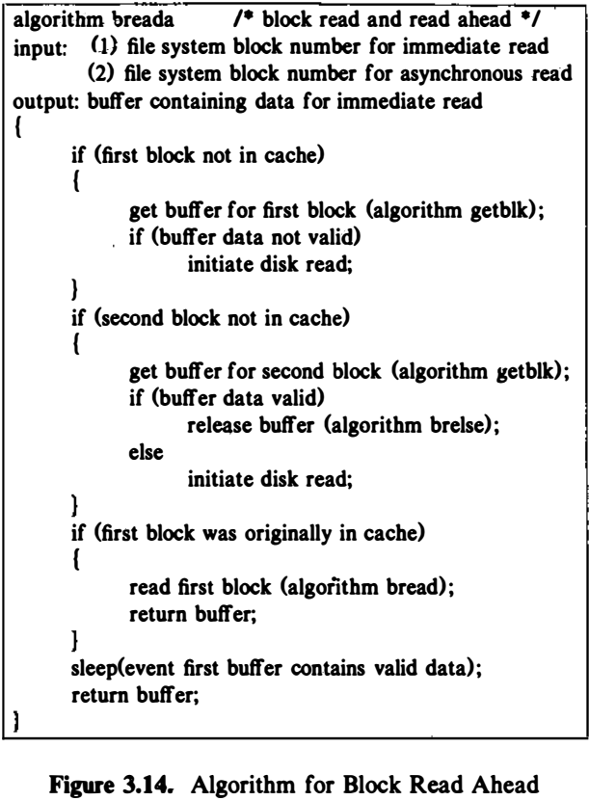

Slide 36
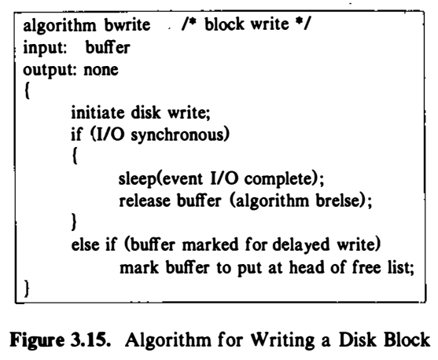
Writing disk blocks

Slide 37
Advantages and disadvantages of buffer cache
Advantages:
Increase throughput and decrease response time
Allows uniform disk access
No alignment restrictions on user processes doing I/O
Kernel aligns data internally
Reduce the amount of disk traffic (less disk access)
Delayed-write
Insure file system integrity
A common, single image of disk blocks contained in cache

Slide 38
Advantages and disadvantages of buffer cache
Disadvantages:
Take time to write data on disk
Lost data from buffers (system crashes, delayed write)
Require extra data copy

Slide 39
Summary
The buffer algorithms combine several simple ideas to provide a sophisticated caching mechanism.
The kernel uses the least-recently-used replacement algorithm to keep blocks in the buffer cache, assuming that blocks that were recently accessed are likely to be accessed again soon.
The hash function and hash queues enable the kernel to find particular blocks quickly, and use of doubly linked lists makes it-easy to remove buffers from the lists.
The locking mechanism ensures that only one process at a time manipulates a buffer.

Slide 40
Reference
The Design of the UNIX Operating System, by Maurice J. Bach

